Slide 1

Barista Simulator
Angelo Indre

Slide 2

Game Overview
In Barista Simulator, the player is a barista working at a coffee shop. Customers come in and the player can
Take their order
Grab croissants and coffee
Serve customers their correct order
Throw away incorrect orders

Slide 3
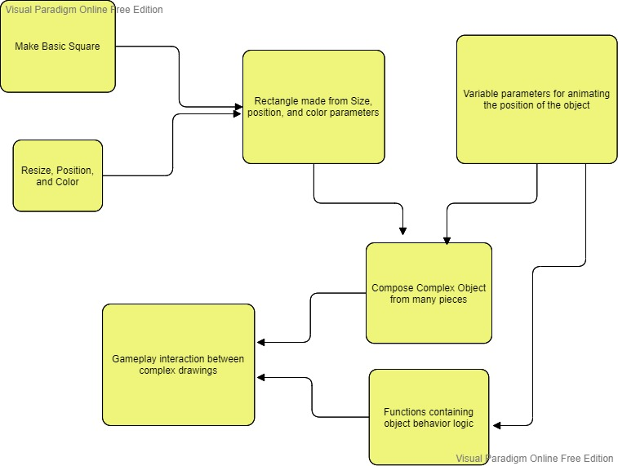
Implementation

Slide 4

Tools Used and Issues
This game was made entirely with WebGL.
Making complex objects from lines of code takes an extremely long time.
Implementing customers as a set of lists rather than a class was not only difficult, but is difficult to extend.

Slide 5
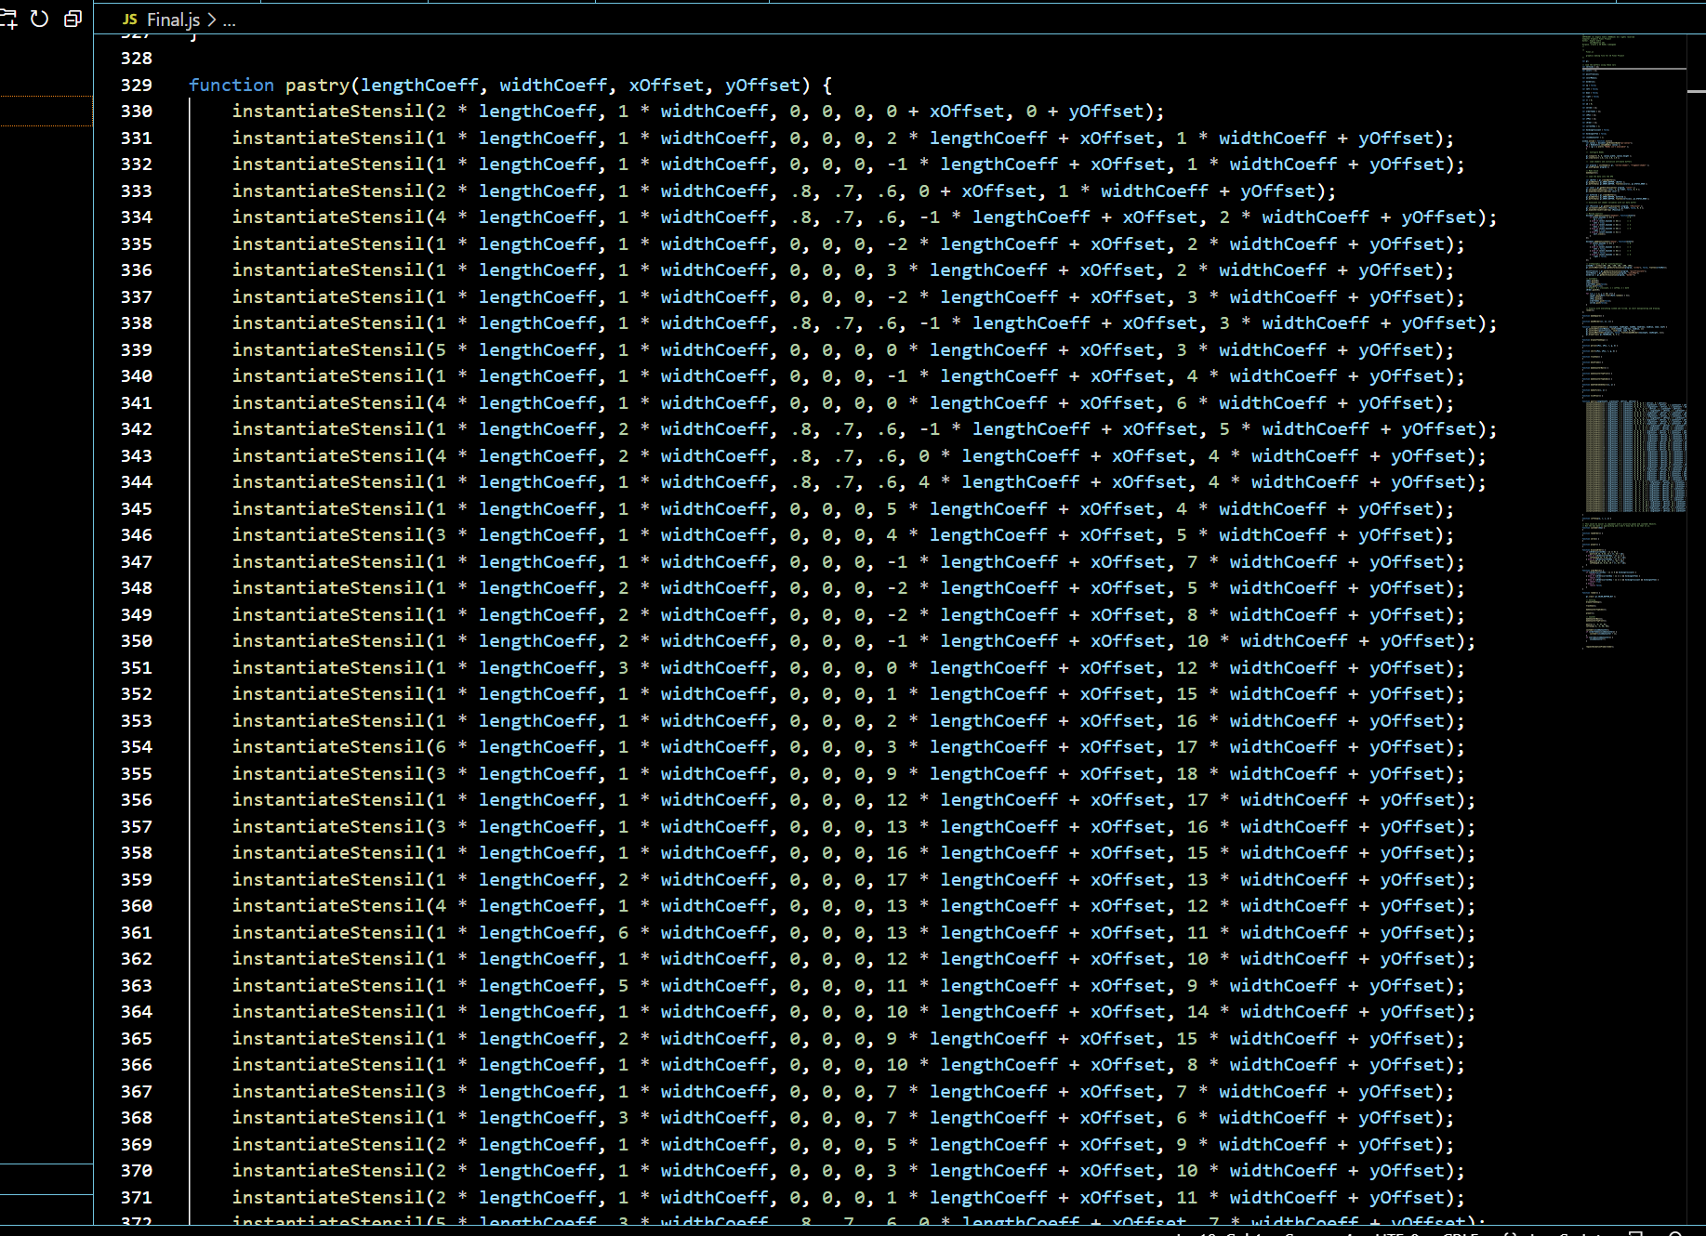
Conclusion
Through synthesizing small pieces together, I build a cute, yet complex videogame in WebGL. But some of the design was very tedious and slow, something that external graphics aids would help with a lot.

